Slide 1

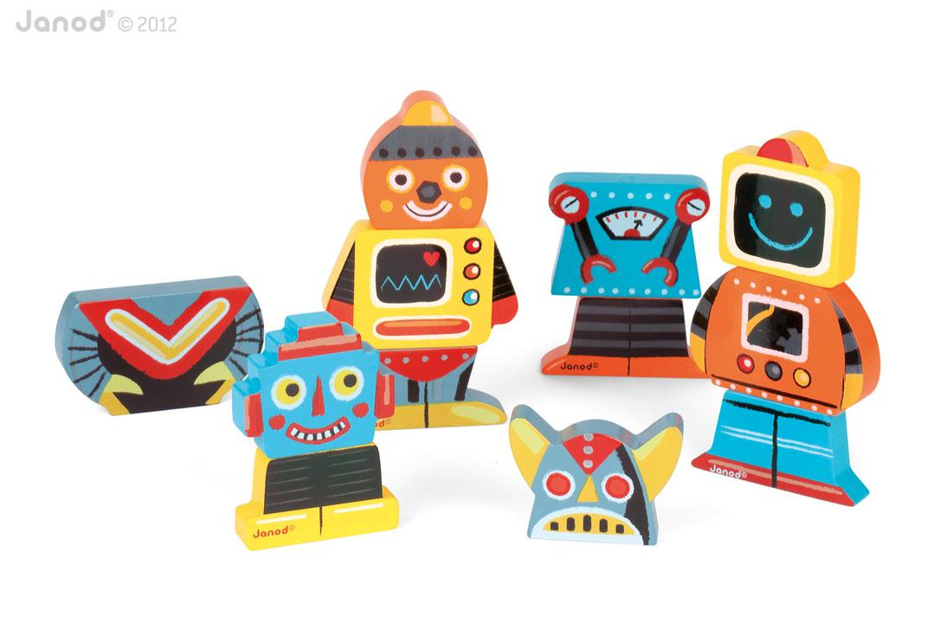
4 Robot Magnets
Toy Name
4 Robot Magnets
Manufacturer
Janod
Age
18– 36 months
Parts
12 Wooden Magnetic Robot Parts
Develop Skills
Fine Motor
Imagination
Cognitive
How it Works
Anak Anda dapat memasangkan dan menukar bagian-bagian robot untuk membuat robot yang lucu. Mainan ini membantu mengembangkan ketangkasan, imajinasi, dan kemampuan dalam membuat asosiasi.
-
Children can mix and match to create their own funny robots. Helps develop dexterity while enhancing imagination and association skills.
How To Clean
Simply clean using a cloth that has been sprayed with non-toxic anti bacterial solution
Warning
Store in a dry place
Keep out of direct sunlight

